Slide 1

Making this resource work for you
Prior to teaching this lesson, please refer to the ‘Unit Overview and Planning Document’.
Further guidance on planning Science Mastery lessons can be found in the detailed planning guidance document.
Refer to the ‘notes’ section on each slide for useful information, including suggested expositions, pedagogical content knowledge, suggested questions, answers and more. Consider using presenter mode so you can see this guidance throughout the lesson.
The introduction slides can be adapted to suit your teaching style and the needs of your class.
Before the lesson, adapt the fix-it slide to address any misconceptions identified in the previous lesson’s exit ticket.
Choose from the suggested activities to suit your class. The intention is not that you complete all of these, but that you select those which ones are most appropriate for your students. It may be appropriate to further adapt activities for your students.
These lessons are designed to occupy approximately 1 hour. To adapt for a shorter or longer lesson duration we advise you to adapt the activity section accordingly.
Please consider using the final slide to send feedback about this lesson or examples of PowerPoints that you have adapted to our design team. Your feedback is used to improve Science Mastery for all of our teachers and students. We appreciate all suggestions and comments.
Thank you for reading!
The Science Mastery Team

Slide 2
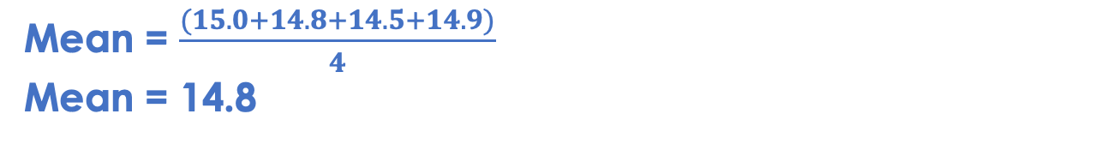
Uncertainty
Answer the questions below.
A student measured the volume of hydrogen given off in the reaction between hydrochloric acid and magnesium. Their results are shown below.
Identify an error in this results table.
Calculate the mean of these results.
Calculate the range of these results.
Write a word equation for this reaction.
Identify the reactants and products of this reaction.
The volume of hydrogen produced does not have a unit.
Trial | Volume of hydrogen produced
1 | 15.0
2 | 14.8
3 | 14.5
4 | 14.9
Mean = $\frac{(15.0+14.8+14.5+14.9)}{4}$
Mean = 14.8
Range = 15.0 - 14.5
Range = 0.5
Magnesium + hydrochloric acid → magnesium chloride + hydrogen
Magnesium and hydrochloric acid are the reactants, magnesium chloride and hydrogen are the products.
Notes:
Foundation: Explain the difference between relative atomic mass and relative formula mass.
Answer: The relative atomic mass is for one element and takes into account the abundance of each isotopes, whereas the relative formula mass takes into account all of the relative atomic masses in the formula of the compound or molecule.
Stretch: Write a balanced symbol equation for this reaction.
Answer: Mg + 2HCl → MgCl₂ + H₂

Slide 3
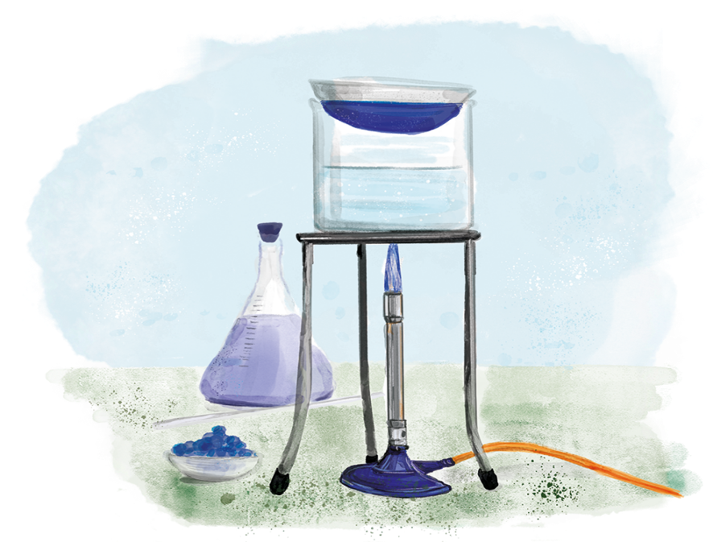

C3.2.6
17/04/2024
Uncertainty
C3.2.1 Prior Knowledge Review
C3.2.2 Relative Formula Mass
C3.2.3 Percentage by Mass
C3.2.4 Conservation of Mass
C3.2.5 Balancing Equations
C3.2.6 Uncertainty
C3.2.7 Introducing Concentration
C3.2.8 Concentration Calculations
C3.2.9 Soluble Salts
C3.2.10 Making Soluble Salts
C3.2.11 Making Soluble Salts 2

Slide 4

Following this lesson, students will be able to:
Describe the two ways of estimating uncertainty
Estimate the uncertainty from a measuring instrument
Estimate the uncertainty from a set of repeat measurements
Key Words:
uncertainty
instrument
repeat
resolution
range

Slide 5
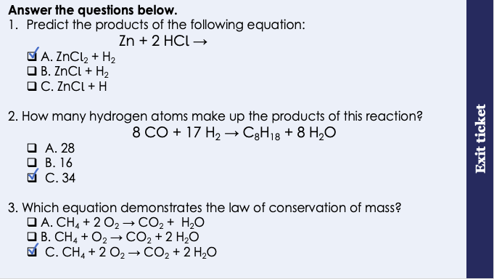
This is the fix-it portion of the lesson
The fix-it is an opportunity to respond to gaps in knowledge, especially those identified by the previous lesson’s exit ticket.
The teacher should customise this slide as needed, to facilitate
reteach, explanation, demonstration or modelling of ideas and concepts that students have not yet grasped or have misunderstood.
practise answering specific questions or of key skills.
redrafting or improving previous work.
Notes:
Purpose: to spend time on any gaps identified in previous learning from mastery quiz.
Fix-it guidance from previous exit ticket:
Q1. Answer: A
If students answered B, it suggests they do not think that the coefficient ‘2’ multiplies the chlorine part of the HCl. If students answered C, it suggests that they have ignored the coefficient of ‘2’. To fix-it, show students using molymods model of HCl what that 2 actually means – it’s 2 of the whole molecule. Have students practice counting the numbers of atoms shown in equations.
Q2. Answer: C
If students answered A, it suggests that they have added 18 to 10, 10 being the number of atoms of hydrogen they’ve incorrectly calculated is in H2O. In this case, students have added the 8 and 2 together instead of multiplying. If students answered B, it suggests they have only counted the hydrogens in the water, and not in the other product. To fix-it, give students similar equations to count the number of different types of atoms in to practice this. Show students that the atoms may not be together in the equation, and they should count all atoms on the right hand side of the arrow as these are all products.
Q3. Answer: C
If students answered A or B, it suggests that they are either not sure what is meant by conservation of mass or have difficulty recognising a balanced equation. To fix-it, give students equations to help them practice working out if equations are balanced and explain how this links to the law of conservation of mass.

Slide 6

What is uncertainty?
Scientific uncertainty means there is a range of possible values within which the true value of a measurement lies.
In any scientific investigation that involves a measurement, there is always some uncertainty about the result obtained.
A coach recorded the time taken for an athlete to run 100 metres 4 times.
The coach measured the following times:
Trial | Time (s)
1 | 10.58
2 | 10.64
3 | 10.59
4 | 10.62
We can calculate the mean time taken, and we can also estimate the uncertainty.
Notes:
Suggested script:
In any science experiment or investigation that requires measurements to be taken, there is always some uncertainty in the result obtained. This means that although we can be quite sure our method allowed us to collect valid results, it is difficult to say that our results are completely perfect. There are different things that can cause uncertainty, and you may be aware of having some doubts in previous investigations as to how accurate or precise your results may have been. One of the most common sources of uncertainty are when measuring the time taken for something to occur (such as for a reaction to completely finish, or for a physical change of state to finish, or for a solute to dissolve in a solvent).
Another common source of error comes from the instrument or measuring apparatus that is being used. For example, if we want to measure a volume of 22 cm3, we will need to use a measuring cylinder that allows us the resolution to do this. We could use a measuring cylinder that has intervals of 1 cm3, but this would still mean that the actual volume we measure could be anywhere between 21.5 and 22.5 cm3.
Scientific uncertainty generally means that there is a range of possible values within which the true value of the measurement lies. A result reported with a small uncertainty means that the experimenter is reasonably confident that the true value falls in between the maximum and minimum (plus and minus) values.
A coach recorded the time taken for an athlete to run 100 metres 4 times, so that they could enter the estimated time for a lane draw in an event. They measured these four times. We can be fairly confident that the athlete runs 100 metres in about 10.6 seconds, but that is not a very precise measurement.
We can use these values to calculate the mean, as well as use the repeated measurements to estimate the uncertainty. This gives us a numerical way of explaining how confident we are that the true value (how long it actually takes the athlete to run 100m) falls within our measurements.
Image from pixabay

Slide 7
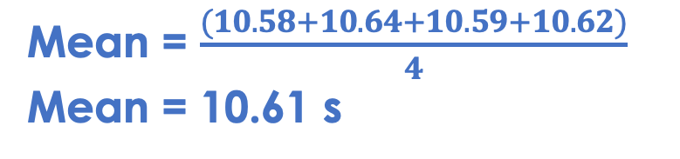

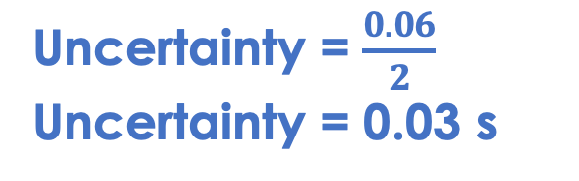
Repeated measurements
Trial | Time (s)
1 | 10.58
2 | 10.64
3 | 10.59
4 | 10.62
We can estimate uncertainty of measurements from the range of repeated measurements.
The uncertainty can be estimated as half the range.
Mean = $\frac{(10.58+10.64+10.59+10.62)}{4}$
Mean = 10.61 s
Step 1: Calculate the mean.
Step 2: Calculate the range by subtracting the smallest value from the biggest value.
Range = 10.64 - 10.58
Range = 0.06 s
Uncertainty = $\frac{0.06}{2}$
Uncertainty = 0.03 s
Step 3: Divide the answer by 2.
Step 4: Write the mean and the uncertainty after the plus or minus symbol.
Time = 10.61 s $±$ 0.03 s
Notes:
Suggested script:
We know that there are many different causes of uncertainty in scientific experiments. We can estimate a numerical value for this uncertainty, and reporting this gives other scientists information about the spread of the data and how precise the measurements or results were. There are two ways we can do this:
Estimating the uncertainty from the range of repeated measurements.
Estimating the uncertainty from the resolution of an instrument.
The range of a set of data tells us how spread out the data is, which can also be described as variation in the data. The larger the range, the more variation there is in the data and the less precise the measurements or results are. In a scientific experiment we should be looking for results that have the smallest uncertainty possible, as this means our results are precise.
We can estimate the uncertainty using the range. The uncertainty is taken as plus or minus (±) half the range. We can follow the following steps to estimate the uncertainty:
Calculate the mean.
Calculate the range by subtracting the smallest value from the biggest value.
Divide the answer by 2.
Write the mean, followed by the uncertainty after the plus or minus symbol.
So what does this actually mean?
This means that although our calculated mean is 10.61 seconds and our uncertainty is very small. This means that we can be reasonably confident that the mean time taken by this runner to run 100 metres falls within 0.03 seconds above or below 10.61 seconds.

Slide 8
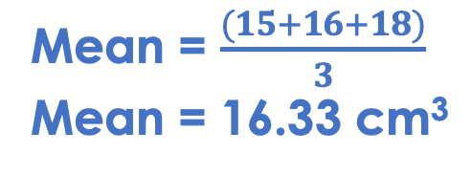
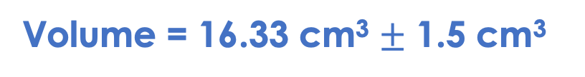
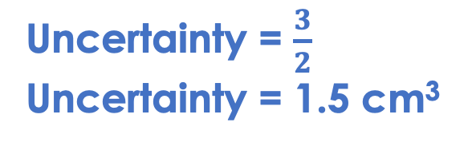
Example 2
Trial | Volume (cm³)
1 | 15
2 | 16
3 | 18
We can estimate uncertainty of measurements from the range of repeated measurements.
The uncertainty can be estimated as half the range.
Mean = $\frac{(15+16+18)}{3}$
Mean = 16.33 cm³
Step 1: Calculate the mean.
Step 2: Calculate the range by subtracting the smallest value from the biggest value.
Range = 18 - 15
Range = 3 cm³
Uncertainty = $\frac{3}{2}$
Uncertainty = 1.5 cm³
Step 3: Divide the answer by 2.
Step 4: Write the mean and the uncertainty after the plus or minus symbol.
Volume = 16.33 cm³ $±$ 1.5 cm³
Notes:
Suggested script:
We can estimate the uncertainty using the range. The uncertainty is taken as plus or minus (±) half the range. We can follow the following steps to estimate the uncertainty:
Calculate the mean.
Calculate the range by subtracting the smallest value from the biggest value.
Divide the answer by 2.
Write the mean, followed by the uncertainty after the plus or minus symbol.
This means that although our calculated mean is 16.33 cm³, the true value of our mean volume could be as little as 14.83 cm3 or as large as 17.83 cm3. We may not be certain that our mean is exactly 16.33 cm3, but we can be reasonably confident the true value falls within 1.5 cm3 above or below it.

Slide 9
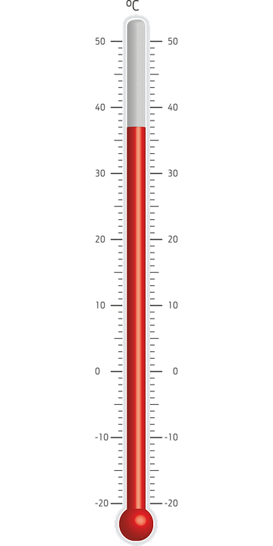
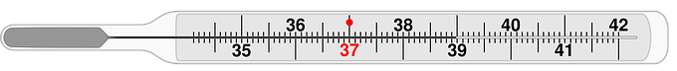
Resolution of instruments
We can also estimate uncertainty of measurements from the resolution of the instrument.
The uncertainty can be estimated as half the smallest interval.
For a thermometer with resolution of 1 ºC, the uncertainty is 0.5 ºC.
Notes:
Guidance: This part of the skill is only required for chemistry separate science, although it is a useful skill for students to cover and can help consolidate their understanding of precision, resolution and reading a scale.
Suggested script:
The other way we can estimate the uncertainty of measurements is by using the resolution of the instrument. The instrument refers to whichever piece of apparatus is being used to do the measuring. The resolution of an instrument is the smallest interval that can be measured using that instrument. For example, a thermometer which has every 1.0 ºC (left) marked on has a resolution of 1.0 ºC, and a thermometer which has intervals marked on every 0.1 ºC (right) has a resolution of 0.1 ºC. The smaller the intervals, the greater the resolution of an instrument. A high resolution allows us to take the most precise measurements possible.
The uncertainty of a measuring instrument is estimated as plus or minus (±) half the smallest interval. For our thermometer with resolution of 1.0°C, the uncertainty is ± 0.5°C. What this actually means is that a student made a measurement of 37.0 ºC using this thermometer, the actual temperature could be as low as 36.5 ºC or as high as 37.5ºC. If it was lower than 36.5 ºC, the student would read this as 36.0 ºC and if it was higher than 37.5ºC, the student would read that as 38 ºC. We can can call these values (36.5 ºC and 37.5 ºC) our minimum and maximum measurements.
This is written in the same way as estimating uncertainty from repeat measurements, with the mean followed by the uncertainty. The value is stated, followed by the uncertainty, so for a measurement of 37.0 ºC, it would be written as 37.0 ºC ± 0.5 ºC. Using an instrument with a higher resolution would reduce the uncertainty of measurements.
If our instrument is a digital measuring instrument, such as a mass balance, the uncertainty is half the last digit shown on its display (as this is then the smallest interval). For a mass balance reading to 0.01 g, the uncertainty is ± 0.005 g. This means that if we measured a mass of 5 g, our minimum possible value would be 4.995 g and the maximum possible value would be 5.005 g.
Images: pixabay

Slide 10
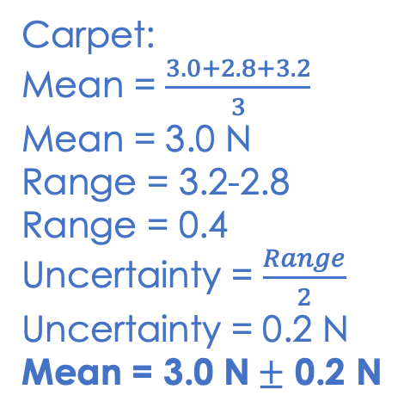
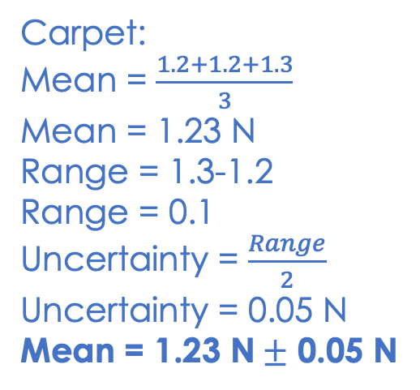
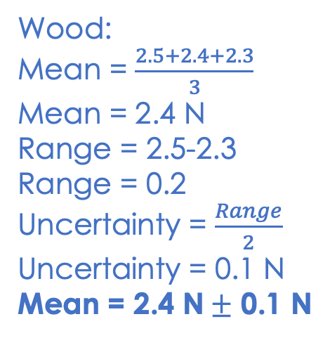
Estimating the uncertainty
Material | Repeats | Force (N)
Carpet | 1 | 3.0
 | 2 | 2.8
 | 3 | 3.2
Wood | 1 | 2.5
 | 2 | 2.4
 | 4 | 2.3
Metal | 1 | 1.2
 | 2 | 1.2
 | 3 | 1.3
A student investigated the friction generated by different surfaces.
Calculate the mean and estimate the uncertainty of each set of data.
Carpet:
Mean = $\frac{3.0+2.8+3.2}{3}$
Mean = 3.0 N
Range = 3.2-2.8
Range = 0.4
Uncertainty = $\frac{Range}{2}$
Uncertainty = 0.2 N
Mean = 3.0 N$±$ 0.2 N
Wood:
Mean = $\frac{2.5+2.4+2.3}{3}$
Mean = 2.4 N
Range = 2.5-2.3
Range = 0.2
Uncertainty = $\frac{Range}{2}$
Uncertainty = 0.1 N
Mean = 2.4 N$±$ 0.1 N
Carpet:
Mean = $\frac{1.2+1.2+1.3}{3}$
Mean = 1.23 N
Range = 1.3-1.2
Range = 0.1
Uncertainty = $\frac{Range}{2}$
Uncertainty = 0.05 N
Mean = 1.23 N$±$ 0.05 N
Notes:
Guidance:
This is designed to give students an opportunity to practice writing the mean with the uncertainty in the correct format. You may want to add some stretch questions for students to consider:
Which data set has the highest uncertainty? The carpet
What does this tell you about the data? There is more variation in the results for the carpet, the results are less precise.
How could the uncertainty be reduced? Use an instrument with higher resolution to increase the precision of measurements.

Slide 11
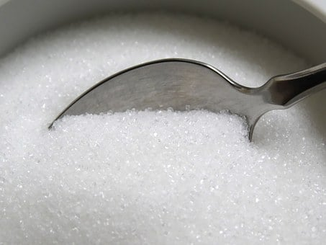
Sources of Uncertainty
A group of students are investigating the effect of temperature on the number of spoons of sugar that can be dissolved in a cup of tea.
How could these students estimate the uncertainty of their measurements?
What would the possible sources of uncertainty be in their investigation?
How could students reduce the uncertainty in their investigation?
Notes:
Guidance:
This can be used as an opportunity to get students to share and explain their ideas to identify any misconceptions and correct any confusion.
They could take repeat measurements, and the uncertainty would be half the range of their results OR they could estimate the uncertainty using the instrument, which in this case is the spoon. The uncertainty would be the smallest interval divided by 2, so in this case half a spoonful.
It may be difficult to judge when all the sugar has dissolved. A spoonful is a large interval, so there may be half a spoonful that dissolves but this would not be counted as the whole spoonful did not dissolve.
They could use the mass of sugar that dissolved instead, or use smaller intervals, such as smaller spoons so that they would have smaller intervals.
Suggested guidance:
Talk tasks can be used in a variety of ways to suit the particular needs of the students you are teaching. Through exchanging views with others, students develop their understanding of the science beyond what could be achieved individually.
Science classrooms that successfully integrate talk have the following features:
Science talk is a regular feature of lessons and is woven into classroom activities.
Students are paired or grouped strategically by the teacher to ensure productive interaction. This might take into consideration the students’ proficiency of the English language, how encouraging they might be to peers and their attainment in the topic. It’s a good idea to consider these pairings in the class seating plan.
Students are encouraged and supported to talk, but are not forced to talk.
The teacher should take on the role of a facilitator, engaging with conversations where necessary and encouraging or steering the conversation where needed.
Students are encouraged to use the language they have to express their ideas (e.g., everyday language, imperfect English, native language), but also to incorporate science specific terminology where this is more accurate or has been taught.
6. Scientifically inaccurate ideas are not dismissed by the partner or teacher; open discussion and further investigation are relied on to help students construct ideas that support them to progress in their scientific understanding.
7. Guidelines for behaviour during talk tasks are explicit and frequently reviewed. Rules for students might be:
Listen carefully to your partner
Take turns talking.
Speak one at a time, without interrupting.
Politely agree or disagree and explain why.
Politely point out if your partner has used a scientific word incorrectly, if they have explained the science incorrectly, or if there is a more accurate way to describe something.
If confused, ask questions.
Stay focused on the discussion topic.
Respond to one another.
Image from pixabay

Slide 12
Drill
Define uncertainty.
How do you calculate mean?
How do you calculate the range? How do you calculate uncertainty?
What does 10± 0.5 mean?
What is resolution?
What is the resolution of this thermometer?
What is the uncertainty of this thermometer
How can you increase the accuracy of your measuring device?
Notes:
Purpose: This is a knowledge drill. The purpose of this is to check that the critical knowledge is secure before pupils move onto independent practice.
Suggested guidance: There are a range of ways this could be done depending on time and ability range of the class:
Mini whiteboards
As full sentences in exercise books
As short answers in exercise books
In the pupil workbook
As pair talk
As cold call

Slide 13
Drill answers
There are a range of possible values within which the true value of a measurement lies Add up the values and divide by however many there are Highest value - lowest value Range divide by two The true value lies somewhere between 9.5 and 10.5 How much a value goes up by on a measuring device 0.1°C 0.5°C Have a greater resolution, so instead of going up in 1 go up in 0.1
Notes:
Purpose: This is a knowledge drill. The purpose of this is to check that the critical knowledge is secure before pupils move onto independent practice.
Suggested guidance: There are a range of ways this could be done depending on time and ability range of the class:
Mini whiteboards
As full sentences in exercise books
As short answers in exercise books
In the pupil workbook
As pair talk
As cold call

Slide 14
I : Uncertainty
A group of students are investigating the volume hydrochloric acid needed to neutralise calcium carbonate needed to neutralise.
They are unsure about the apparatus needed to measure 20 cm³ of acid. Help them decide using the data below.
Apparatus | Uncertainty | Minimum value | Maximum value | Should they use this?
50 cm³ Beaker | ±10 cm³ | 10 | 30
100 cm³ measuring cylinder | 5 cm³ | 15 | 25
50 cm³ measuring cylinder | 1 cm³ | 19 | 21
50 cm³ burette | 0.05 cm³ | 19.95 | 20.05
No
No
No
Yes
Notes:
Explain how a burette is the most precise apparatus used for measuring volume. The explanation for this is
A beaker is a container used for mixing and has approximate volume values on the side. You can this if you pour 50cm³ of water (demonstrate this) from a beaker to ameasuring cylinder the uncertainty involved. It is not exactly 50cm³ in the measuring cylinder.
You can see the gap between the minimum and maximum values is really large in comparison to the burette.

Slide 15
We: Uncertainty
A group of students are investigating the temperature change in a reaction.
The temperature change is 22.5 ºC.
Which thermometer should they use?
100
200
25
80
150
24
60
100
23
40
50
22
No
Yes
No
21
20
0
Notes:
Explain how third thermometer is the most precise apparatus used for measuring temperature. The explanation for this is
The first thermometer has a resolution of 2 and the second 5. If you look at the first thermometer the resolution of 2 means the trues answer could be anywhere between 20 and 24 so uncertainty is ±1◦C. Where as the last thermometer has a resolution of 0.1 so uncertainty is ±0.05◦C.,meaning the answer is closer to 22 than the first thermometer.

Slide 16
You: Uncertainty
A group of students are investigating the effect of concentration on the volume of hydrochloric acid needed to neutralise 1g of calcium hydroxide. They do repeat measurements to improve the repeatability.
Concentration of acid (mol/dm³⁾ ) | Volume needed to neutralise calcium hydroxide /cm³ |  |  |  | Range | Uncertainty
 | Trial 1 | Trial 2 | Trial 3 | Mean
2 | 14.3 | 14.3 | 14.4
1.5 | 18.5 | 18.4 | 18.6
1 | 26.2 | 24.3 | 26.2
0.5 | 53.6 | 53.9 | 53.2
0.25 | 109.7 | 110.2 | 110.1
14.3
0.1
0.05
18.5
0.2
0.10
25.7
0.3
0.15
53.6
0.5
0.35
110.0
0.5
0.25
Calculate the means, the ranges and uncertainty of each
Decide the concentration with the lowest uncertainty.
2 mol/dm³
Notes:
Images from:
Here they are applying everything from the lesson. The reason why the end answer is 2mol/dm³ is because the range and uncertainty are the smallest

Slide 17
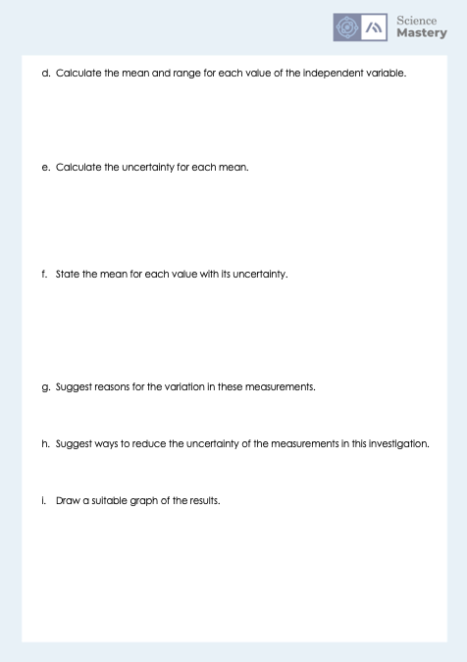
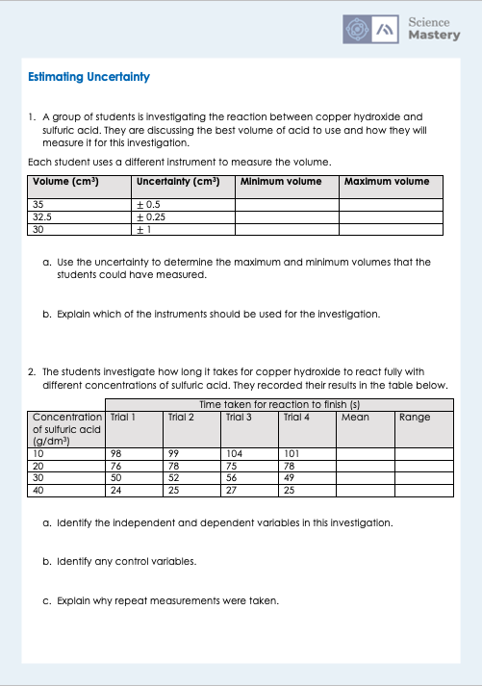
Estimating Uncertainty worksheet

Slide 18
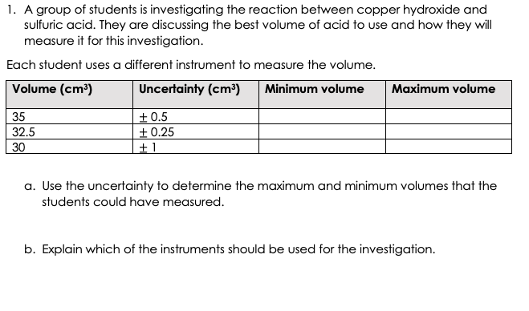
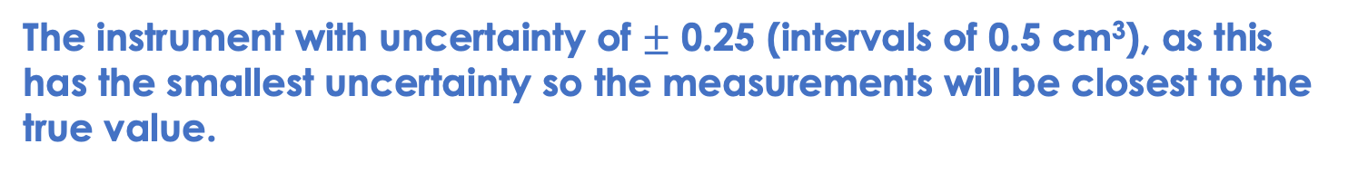
Answers
34.5
35.5
32.25
32.75
29
31
The instrument with uncertainty of $±$ 0.25 (intervals of 0.5 cm³), as this has the smallest uncertainty so the measurements will be closest to the true value.

Slide 19
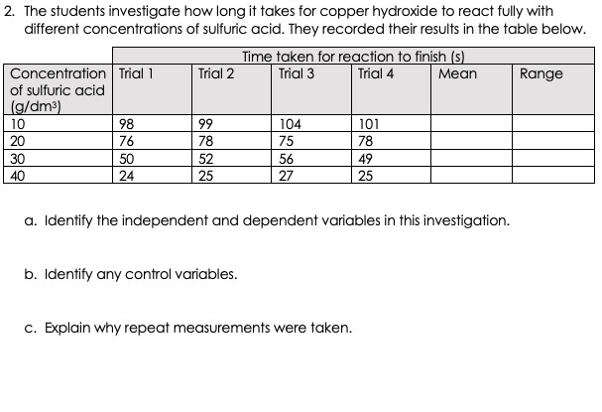
Answers
Independent variable: concentration of sulfuric acid
Dependent variable: time taken for reaction to finish
Mass of copper hydroxide, volume of sulfuric acid, temperature, surface area
To make sure the results more accurate - any anomalous results can be identified and removed before calculating the mean. This ensures that the mean measurement is as close to the true value as possible.

Slide 20
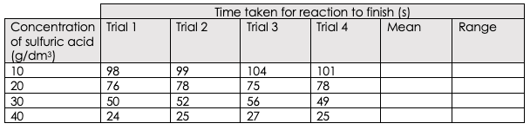
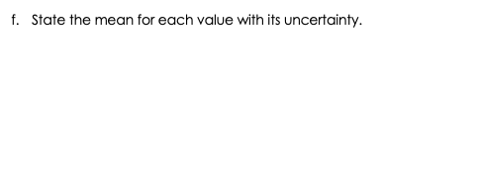
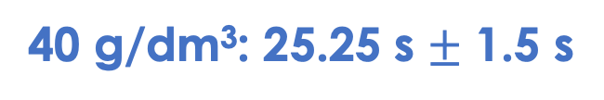
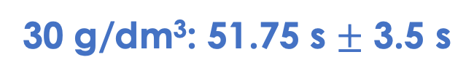
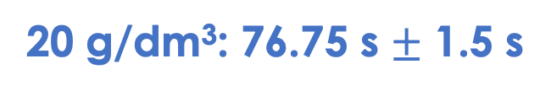
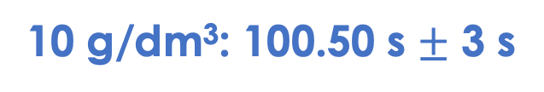
Answers
Uncertainty
100.50
6
3 s
76.75
3
1.5 s
51.75
7
3.5 s
25.25
3
1.5 s
10 g/dm³: 100.50 s $±$ 3 s
20 g/dm³: 76.75 s $±$ 1.5 s
30 g/dm³: 51.75 s $±$ 3.5 s
40 g/dm³: 25.25 s $±$ 1.5 s
Notes:
For some groups it may be appropriate to go through the working for each mean and range calculation.

Slide 21
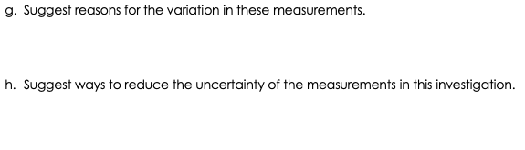
Answers
It may have been difficult to judge the end point of the reaction.
The reaction time of the experimenter may also be included in the time.
Use a digital timer.
Have a quantitative point for when the reaction has ended (such as volume of gas produced or using an indicator to show when neutralisation has occurred).

Slide 22

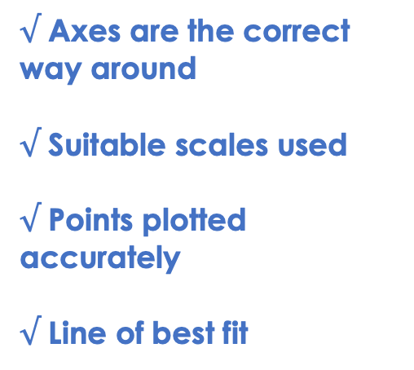
Answers
x
$√$ Axes are the correct way around
$√$ Suitable scales used
$√$ Points plotted accurately
$√$ Line of best fit
x
0 25 50 75 100
x
Time taken for reaction to complete (s)
x
0 10 20 30 40
Concentration of sulfuric acid (g/dm³)
Notes:
This can be used to go through an example graph - ideally graph paper with more intervals should be used for this.

Slide 23
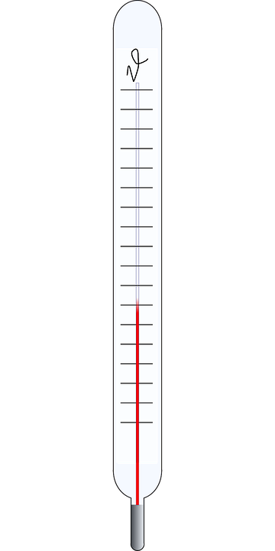
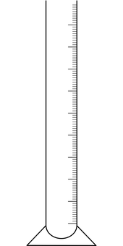
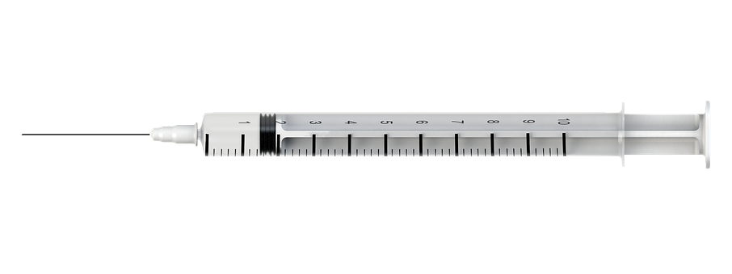
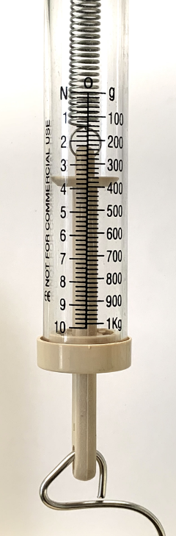
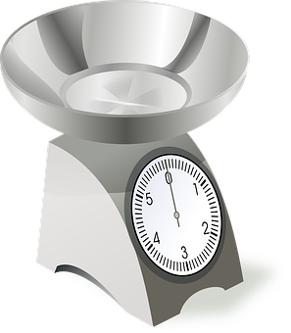
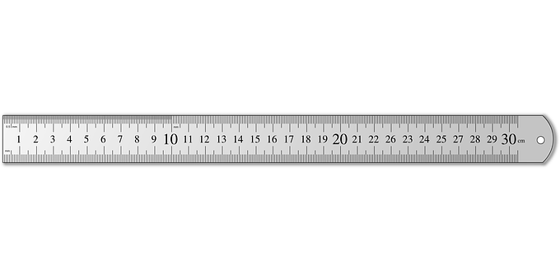
Estimating the uncertainty of instruments
Determine the value shown on each piece of measuring equipment.
Notes:
This can be used as an optional activity. Only chemistry separate science students are required to estimate the uncertainty from an instrument. This is an interesting skill for most students to practice however, and can be used to consolidate their skills in reading a scale.
Guidance:
Set up a carousel of different instruments, where students have to identify the smallest interval on each one and us it to estimate the uncertainty of each instrument. You may also want to give students a value/measurement to aim for, so that they have to use the uncertainty to determine the maximum and minimum actual volumes that could be given for the value using that instrument (as in Q1 of the worksheet).
Possible Apparatus:
Analog weighing scales
Mass balance
Thermometers with different intervals
A newtonmeter
Rulers of different intervals
Gas syringe
Images sourced from pixabay

Slide 24
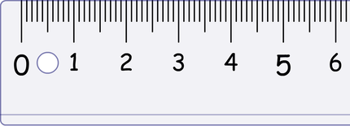
Answer the questions below.
Which is the best definition of uncertainty?
A. The mean and the range of a data set
B. The range of a data set divided by two
C. The range of values within which the true value lies
Estimate the uncertainty of this data set.
A. 3 g
B. 6 g
C. 105 g
Estimate the uncertainty of this instrument.
A. 1 cm
B. 0.1 cm
C. 0.05 cm
✓
✓
Trial | Mass (g)
1 | 102
2 | 108
3 | 105
✓
Notes:
Q1. Answer: C
If students answer A, they have understood that the mean and range are both measurements that can be taken from a data set but have not understood what the idea of uncertainty actually means. If students answer B, they have identified how to estimate it from repeated measurements rather than the definition. To fix-it, reteach the idea of uncertainty within a data set and how to estimate it.
Q2. Answer: A
If students answer B, they have forgotten to divide the range by two. If students answer C they have calculated the mean rather than the uncertainty. To fix-it, give students more practice of estimating the mean from repeated measurements.
Q3. Answer: C
If students answer A, they are not clear on the meaning of the smallest interval, and have only used the numbered intervals. To fix-it, get pupils to practice identifying the intervals on different instruments. If students answer B, they have identified the smallest interval but have not divided by two. To fix-it, get pupils to practice estimating the uncertainty from different instruments.

Slide 25
Lesson C3.2.6
What was good about this lesson? | What can we do to improve this lesson?
Send us your feedback by clicking this link
or by emailing sciencemastery@arkonline.org
Thank you!

